Slide 1
Generating SQL/Reverse Engineering from SQL

Slide 2
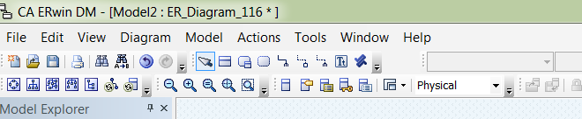
Generate SQL
Change the model to physical
In the Physical model, pick ‘Forward Engineer’ from the ‘ACTIONS’ menu item on the top toolbar.
Choose SCHEMA from the options presented.
Work through the options presented in the following screens and make sure your selections match those presented.

Slide 3

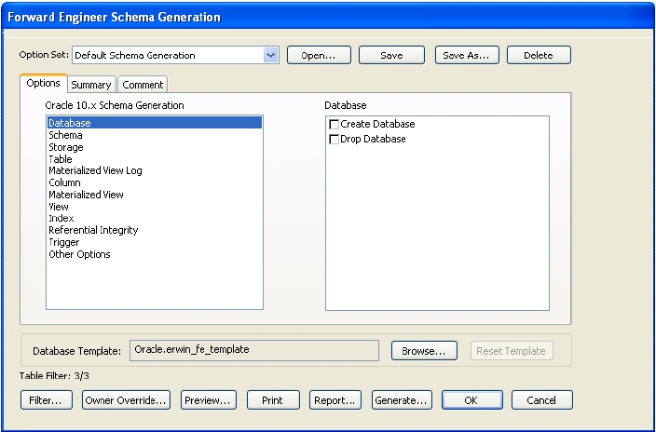
Database option – clear all
You don’t want to create a new database.

Slide 4
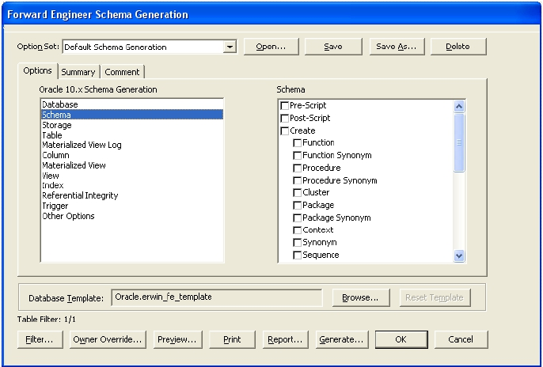
Schema options – clear all
You don’t want to interfere with your schema. You only want to create the tables and relationships between them.

Slide 5
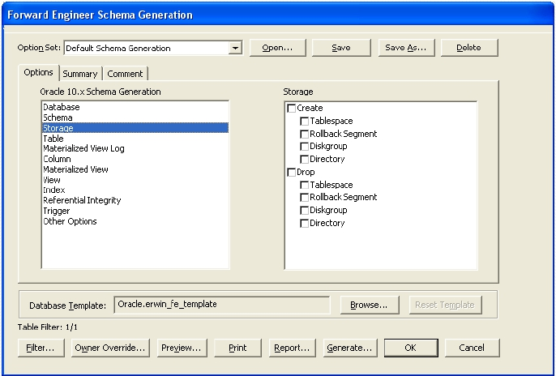
Storage Option – clear all

Slide 6
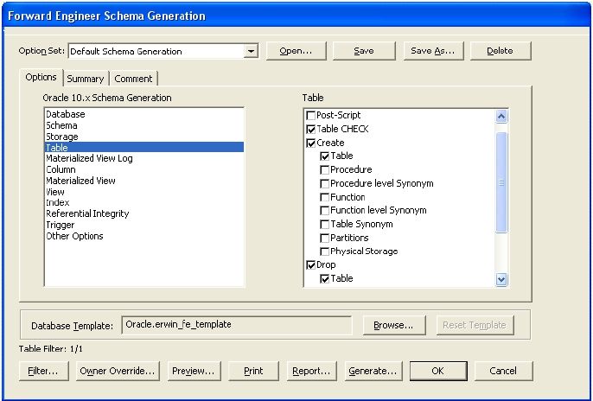
Table options - customise
This is where you need to do some work. So that you can reuse this SQL you want to delete any tables with the same names and create them again.

Slide 7
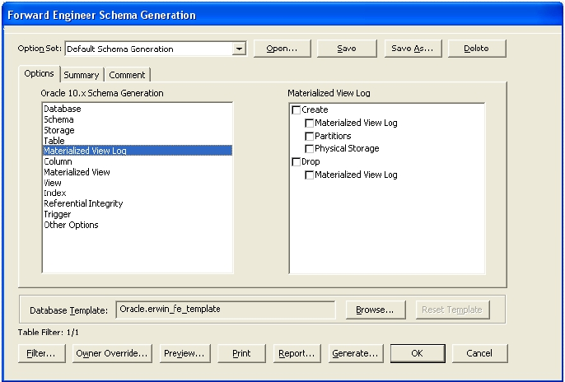
Materialised View Log – clear

Slide 8
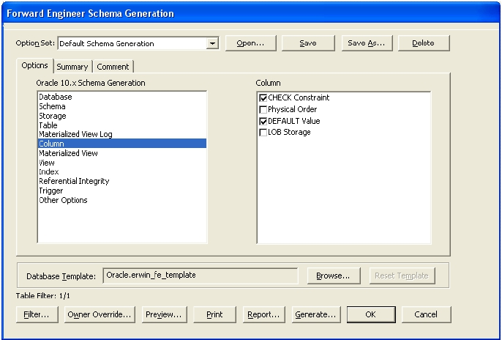
Column options – customise
Make sure you include the generation of any constraints or defaults you created.

Slide 9
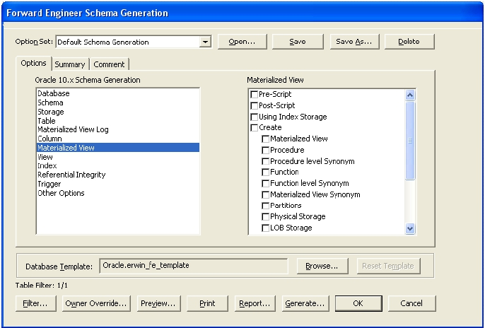
Materialised View – clear all

Slide 10
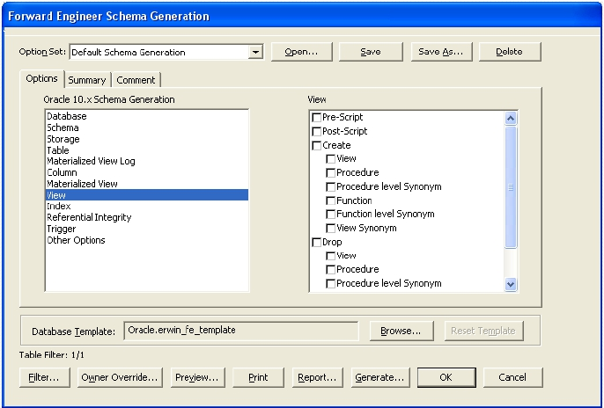
View – clear all

Slide 11
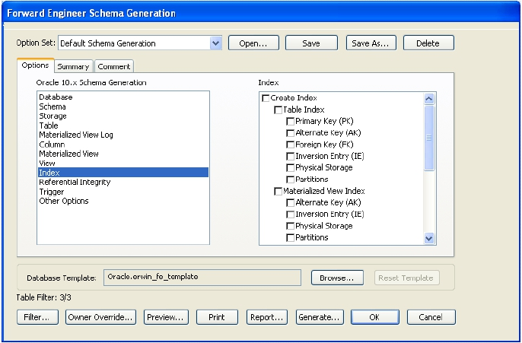
Index options – clear all

Slide 12
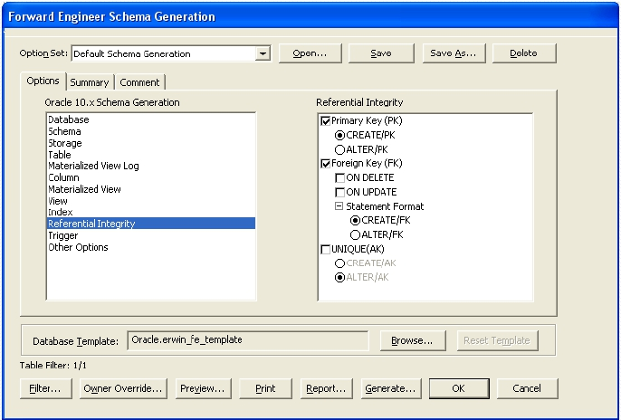
Referential Integrity - customise

Slide 13
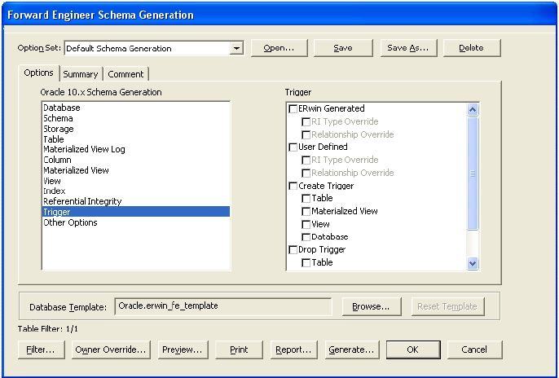
Trigger – clear all

Slide 14
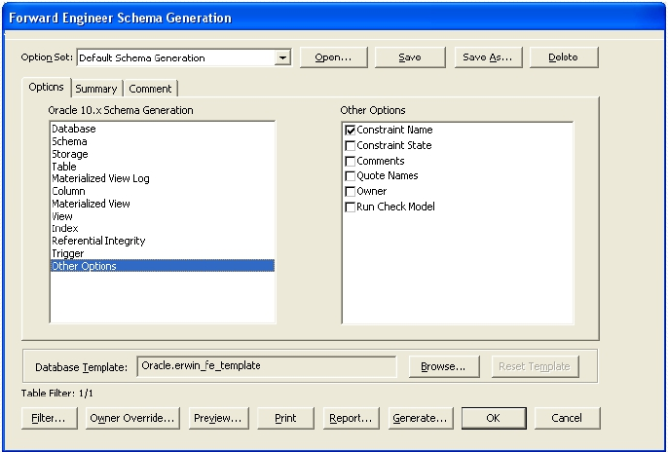
Other options - customise

Slide 15
Table options - customise

Slide 16
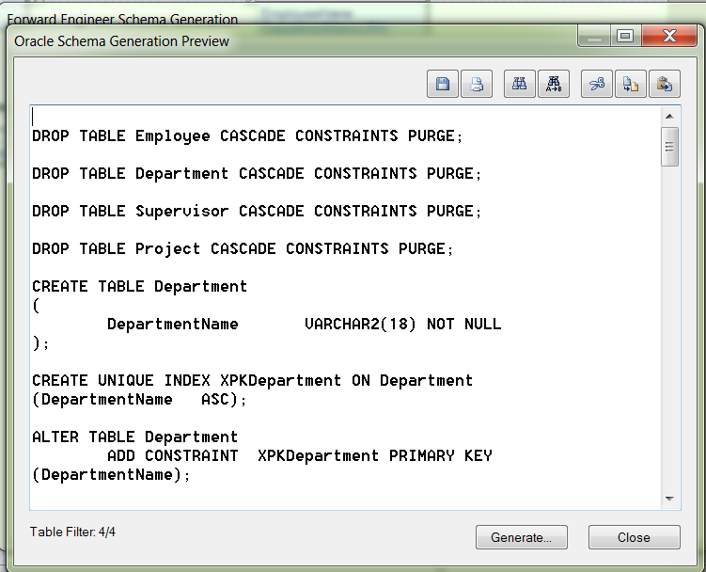
Preview
Select preview from the options at the bottom of the ‘Forward Engineer’ screen

Slide 17
To save your ‘CREATE’s
Pick a name for your code and store it with suffix of .sql.
You can now open this file in SQL Developer and it will create the tables for you.

Slide 18
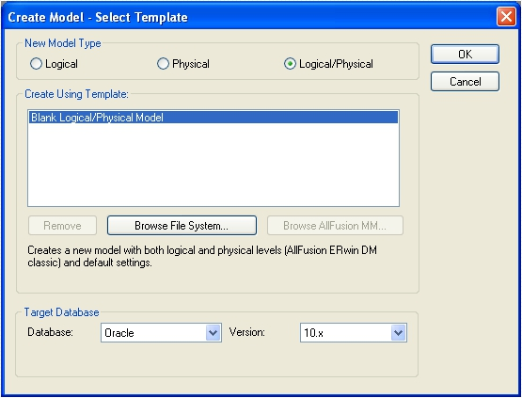
Reverse Engineering
 Open up
ERWin as
before.
 Set up a new
physical /
logical model

Slide 19
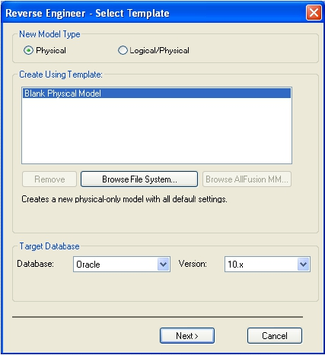
Reverse Engineering
 Choose the tools menu.
 Pick reverseengineer.
 Click Next>

Slide 20
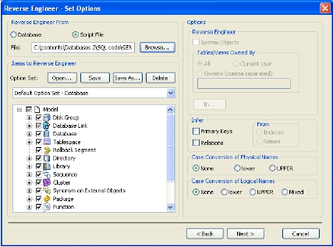
Reverse engineer from script
 Click the radio button
For script file.
 Browse for your script.
 Click next until you get a
model.

Slide 21
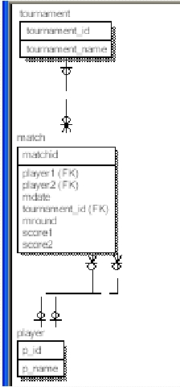
RESULT
 You may need to
rearrange the tables or
change the notation or
formatting, but all the
other information is in
your model.

